Slide 1
Drug Monitoring System
CHAPTER 4: Major System Modules

Slide 2
Major System Modules
Login Module
Registration Module
Add Drugs
Drug Records
Notification
Expired Records

Slide 3
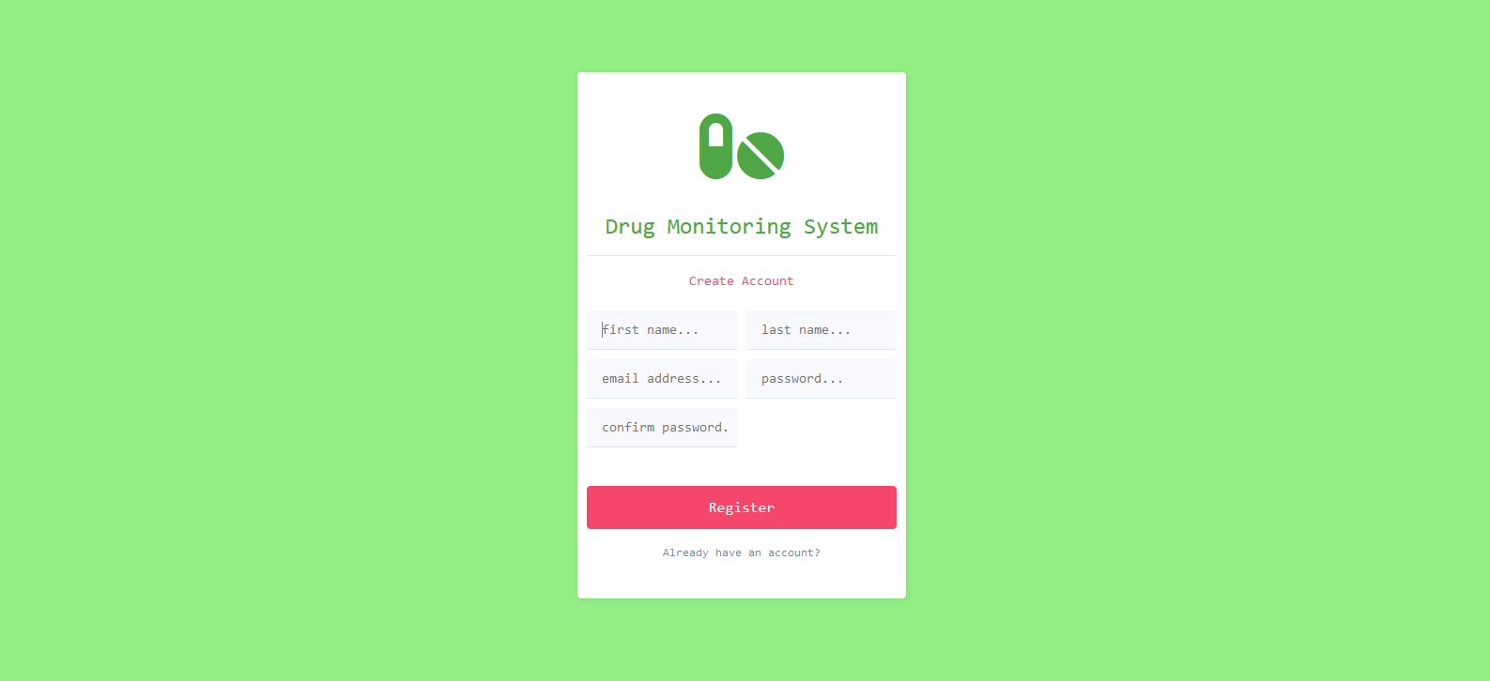
Registration Module
the system registers new users into the system
the user data is saved in the system’s database.

Slide 4
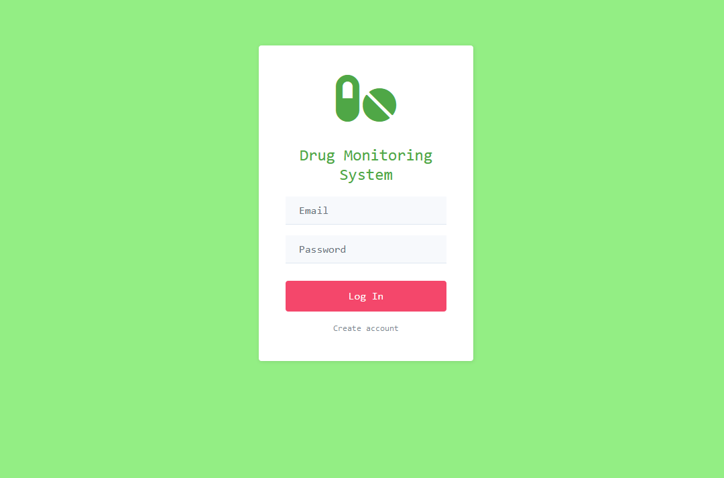
Login Module
The system automatically validates user upon login.
Upon validation, the user is redirected to the main page.

Slide 5
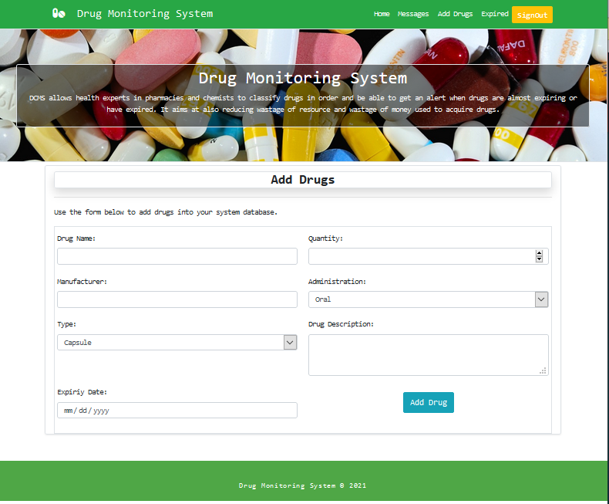
Add Drugs Module
The system captures drug input data from the user
The data (drug information) is the stored in the system’s database
Validation occurs if there is a mismatch in the data entered

Slide 6
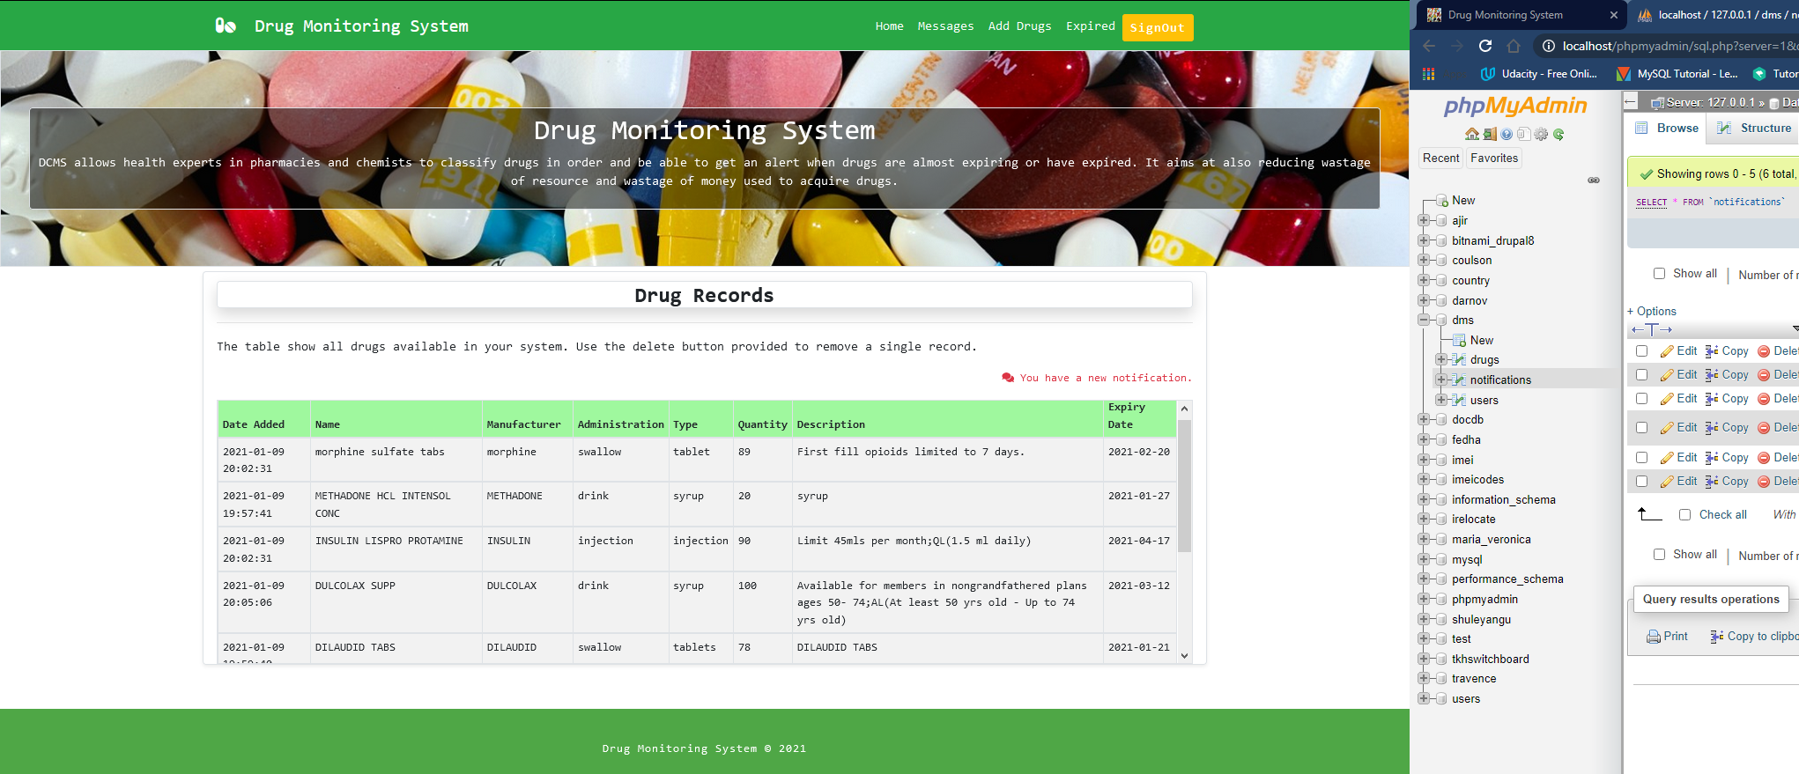
View Drugs Module
The system fetches all drug records from the database.
The system displays this data for the user to view
The system provides information to the user on particular drugs
The user can analyze available drug stock

Slide 7
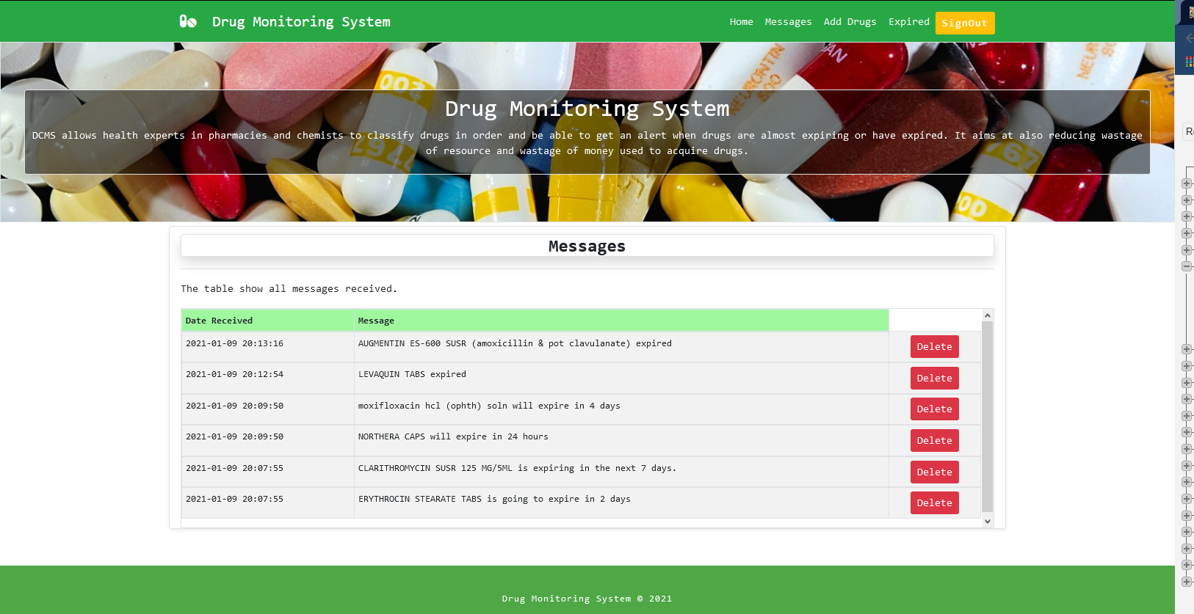
Notifications Module
The system checks for any expiring drug in the database
A notification is sent to the user about the expiring drug.

Slide 8
Tables
Users
Drugs
Notifications

Slide 9
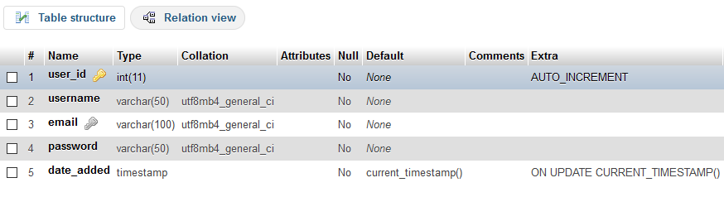
Table Structure (Users)

Slide 10
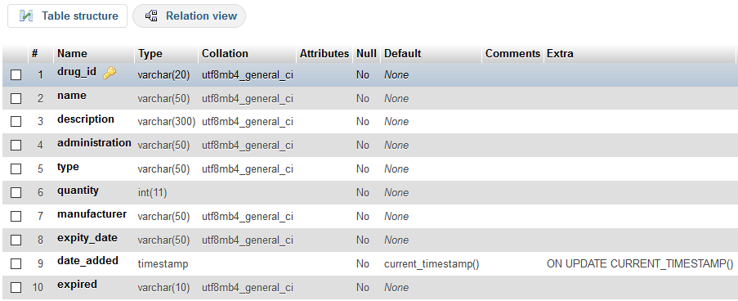
Table Structure (Drugs)

Slide 11
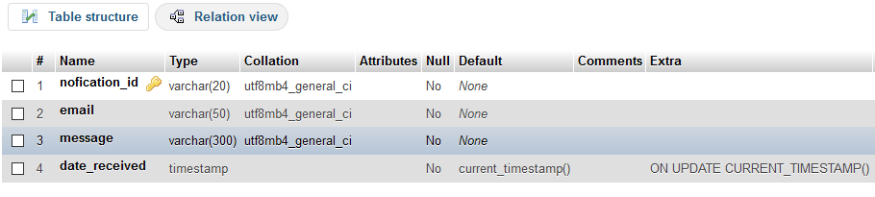
Table Structure (Notifications)

Slide 12
Systems Operations
Login Procedure
Registration Procedure
Add Drugs Procedure

Slide 13
Login Procedure
Enter email and password (ok)
Check database is email exist
If no – alert: User does not exist
if yes – check password match against the given email
if no – alert: the password is incorrect
if yes – redirect user to main page

Slide 14
Registration Procedure
Enter names, email and password (ok)
Check database is email exist
If yes – alert: User already exist, proceed to login
if no – check password match
if no – alert: the two passwords do not match
if yes – Successful Registration

Slide 15
Add Drugs Procedure
take user input from form
insert data into database
if okay – alert: successful
if no – alert: error

Slide 16
The End.
Drug Monitoring System

